Slide 1
How can access to facilities be improved to support a more competitive rail sector?
Duncan Clark
Director, Strategic Development
GB Railfreight (a Hector Rail Group company)

Slide 2
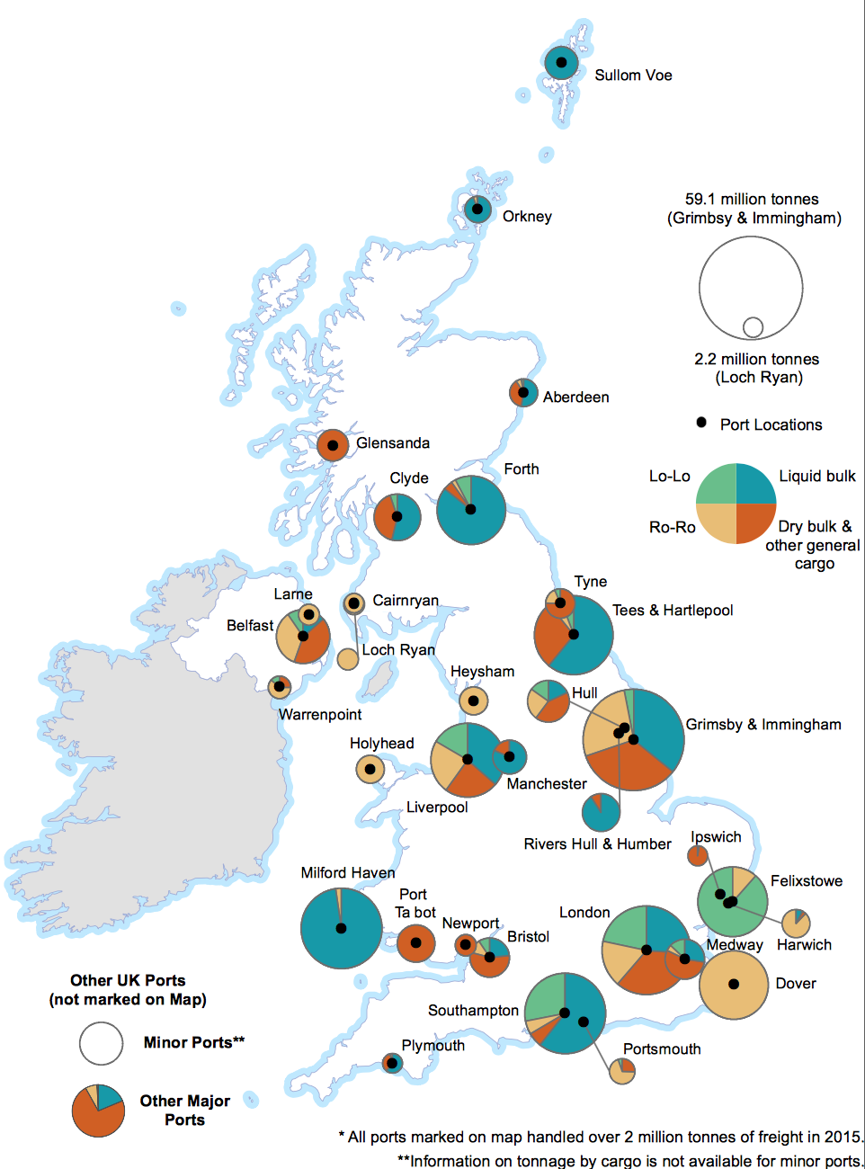
UK Ports & Terminals
RAIL FREIGHT INDUSTRY CODE OF PRACTICE 2013
Does not compel facility owners to adopt and conform
Relies of legislation which is both limited and complex
Notes:
Railways Act 1993 (as amended) (“the 1993 Act”)
Railways Infrastructure (Access and Management) Regulations 2005 (“the 2005 Regulations”)
Guidance on Appeals to ORR under the Railways Infrastructure (Access and Management) Regulations 2005.” This document can be found at the following location: http://www.rail-reg.gov.uk/upload/pdf/275.pdf

Slide 3
UK Ports
Specialism in Ports and terminals can and does lead to localised monopolies where limiting supply can positively affect price.

Slide 4
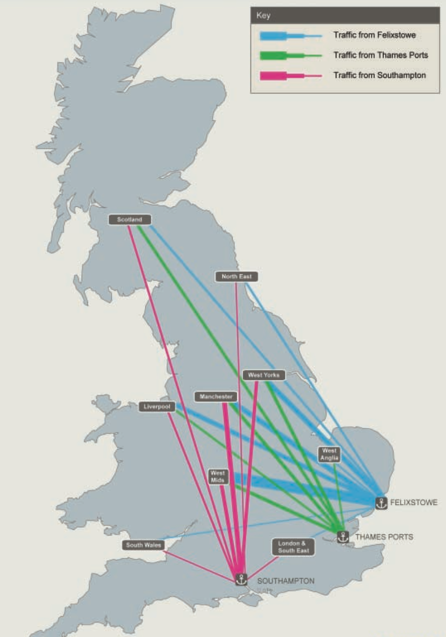
Port of Felixstowe
Three (of 7) Freight Operating Companies service three rail freight terminals
Bespoke Policy for allocation/ auctioning of terminal slots
Capacity constrained until 2020/1
2 out of every 5 Lo-Lo units being handled by Felixstowe.

Slide 5
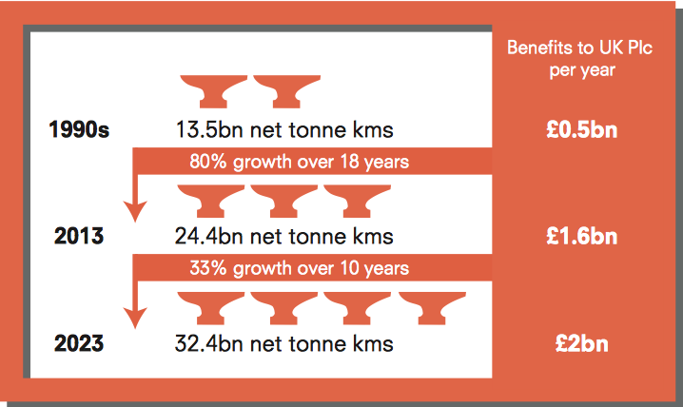
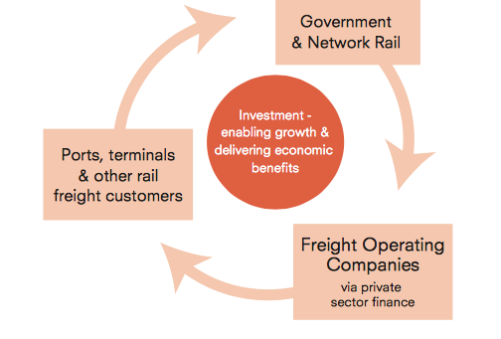
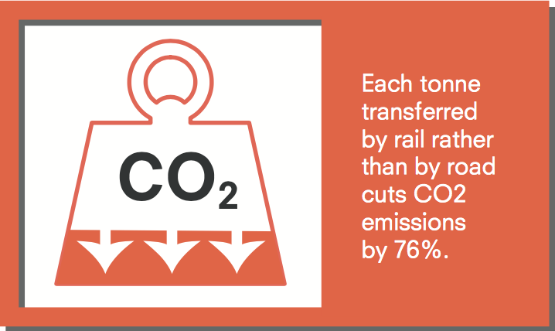
What's at stake?
Only two from the three groups are regulated currently

Slide 6
Determining factors for access
Terminal Capacity
Network Access (Capacity)
Road Side
Terminal Capability
Rail Side

Slide 7
Terminal Features & Ancillary Services
Road Side
Rail Side
Road access
Storage
Lifting & Handling
Transhipment
Equipment repair
Rail shunting (Pilot Engine)
Short lines moves (Arrival/ Departure sidings – Terminal and reverse)
Ground staff activities (Train preparation and administration)
Wagon storage
Wagon and locomotive maintenance access and service supply

Slide 8
Access to Facilities and Ancillary Services
Ports & Terminals Maritime and Inland (e.g. Aggregates, Intermodal)
Depots (Maintenance and Stabling)
Yards and Sidings (Stabling/ Crew Change)
Stations (Passenger and Freight usage)
Transfer/ Cross Dock/ Warehouse locations
Fuelling and Vehicle Wash sites
The ability to access and provide own services with own contractors at third party locations

Slide 9
Self Regulation v’s Government Regulation
Govt
Clarity of purpose
Objective
Self
Misaligned incentives
Governance
Administration
Enforcement
Capacity Custody

Slide 10
What to regulate?
Capacity management
Service costs
Timeliness
Service level delivery
Flexibility and responsiveness
Data/ information transfer
Innovation and cost management/ control

Slide 11
A way forward?
EU Commission
Government Policy
Terminals
Ports
Self Regulatory Body
Facilities

Slide 12
Question & Close

